Slide 1
COVID-19 in numbers
Canada’s Fight against Coronavirus

Slide 2
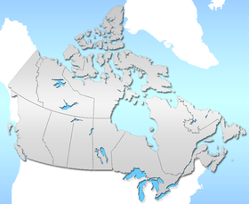
Infection across provinces
This Photo by Unknown Author is licensed under CC BY-SA

Slide 3
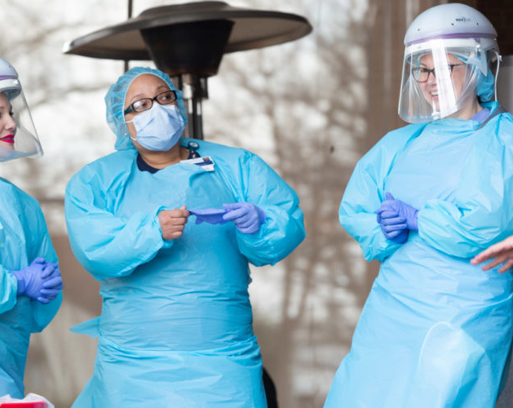
Measures taken across the country
This Photo by Unknown Author is licensed under CC BY-ND

